Slide 1
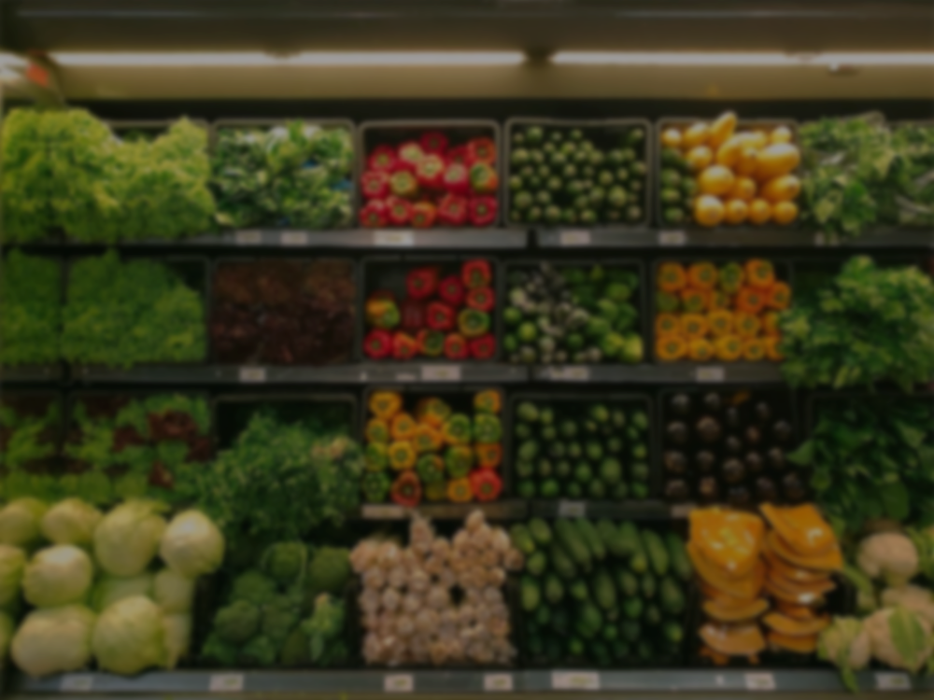
Data Science Grocery Store
X

Slide 2
INTRODUCTION
In this project, I will be performing an unsupervised clustering of data on the customer's records from a groceries firm's database. Customer segmentation is the practice of separating customers into groups that reflect similarities among customers in each cluster. I will divide customers into segments to optimize the significance of each customer to the business. To modify products according to distinct needs and behaviours of the customers. It also helps the business to cater to the concerns of different types of customers.

Slide 3
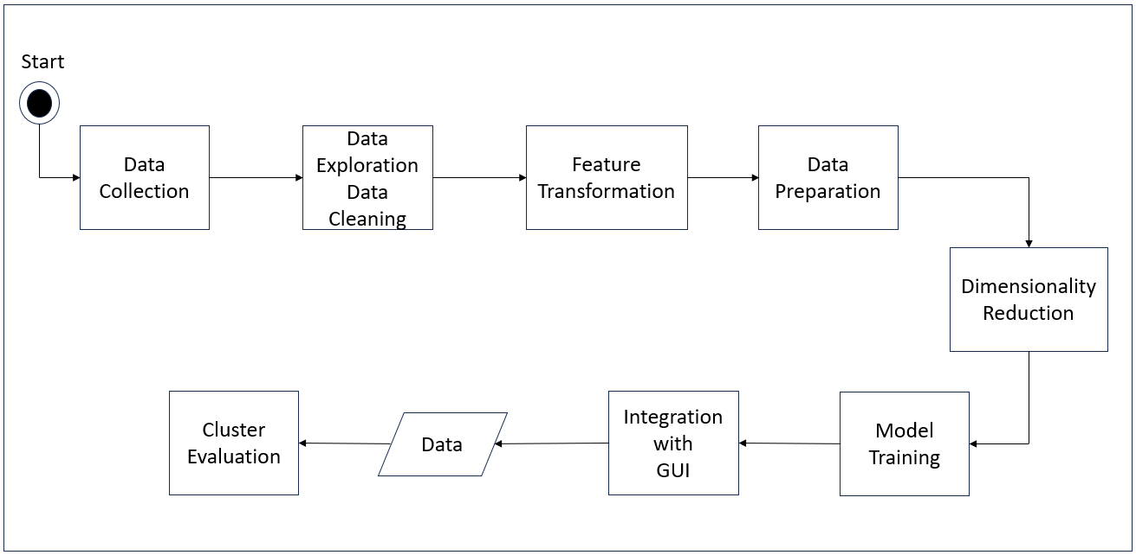
Block Diagram

Slide 4
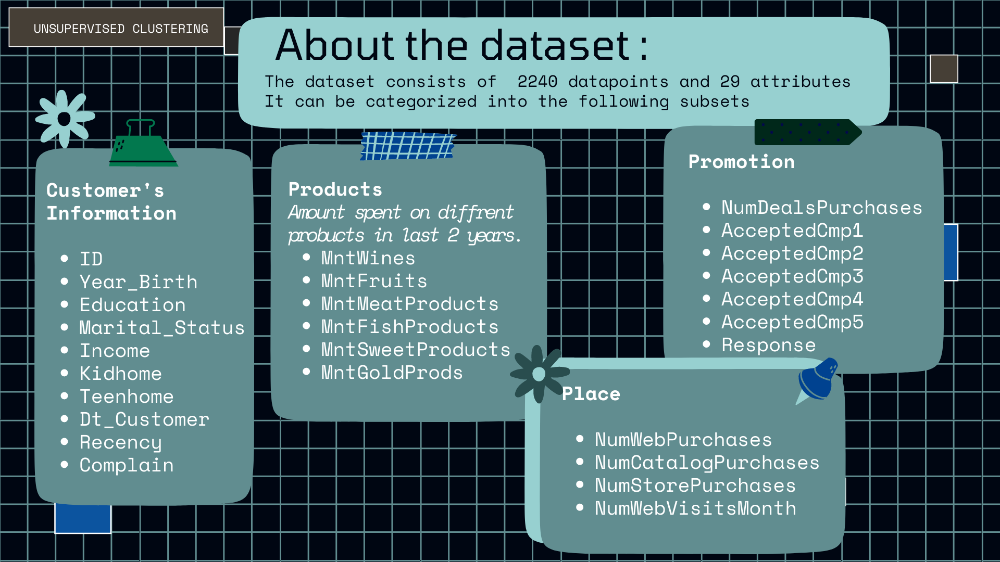

Slide 5
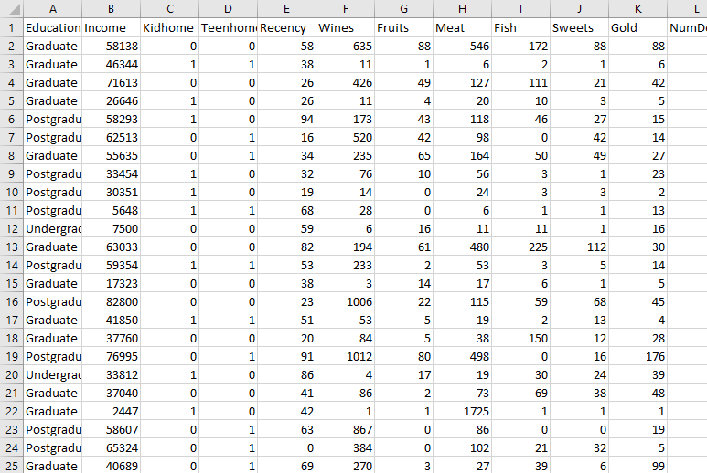
Overview of Dataset

Slide 6
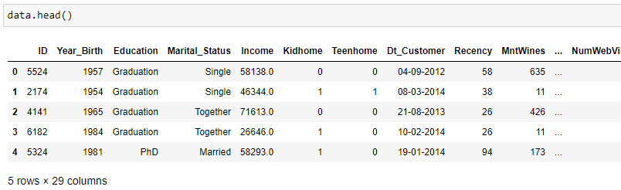
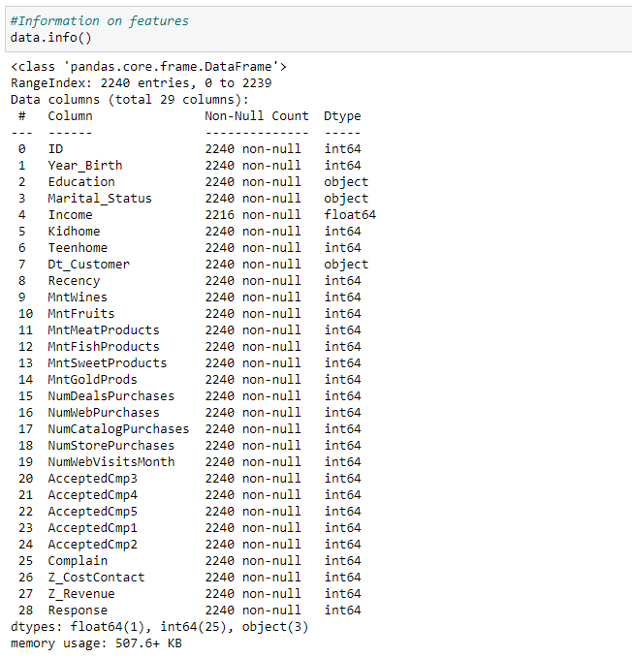
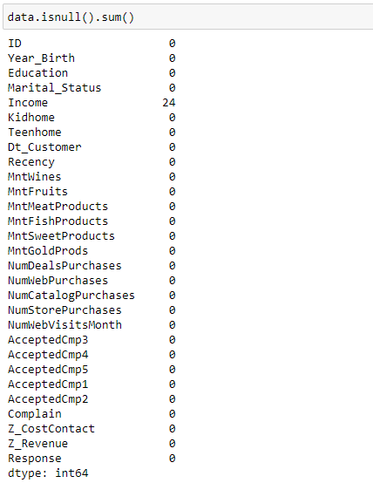
BASIC FUNCTIONS
TO KNOW
ABOUT DATASET

Slide 7
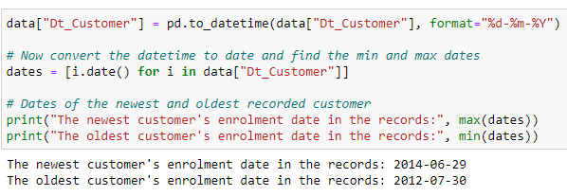
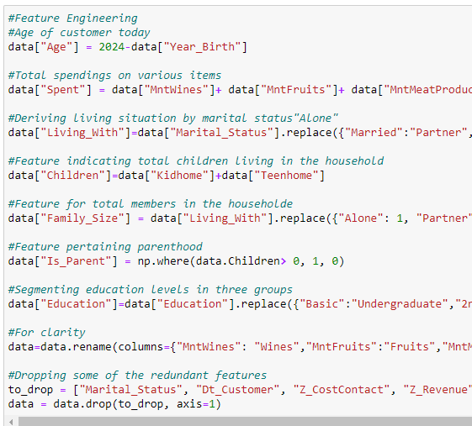
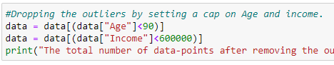
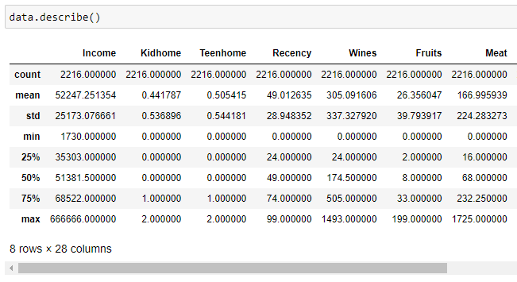
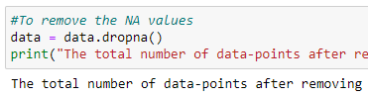
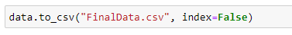
Feature
Engineering

Slide 8
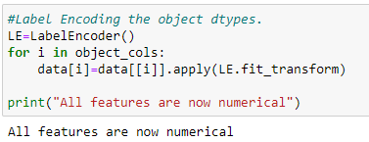
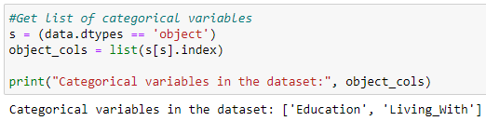
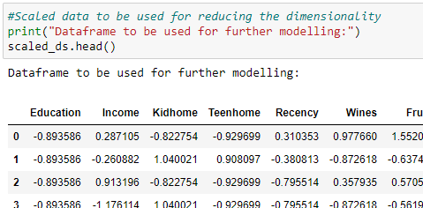
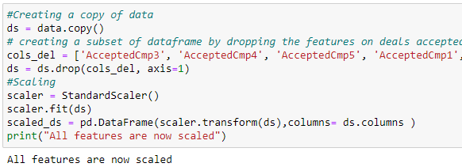
Data Preprocessing

Slide 9
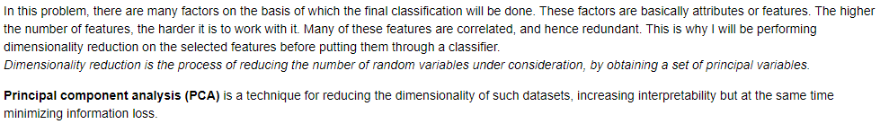
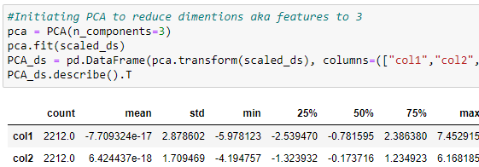
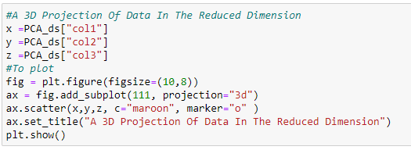
Dimensionality Reduction

Slide 10
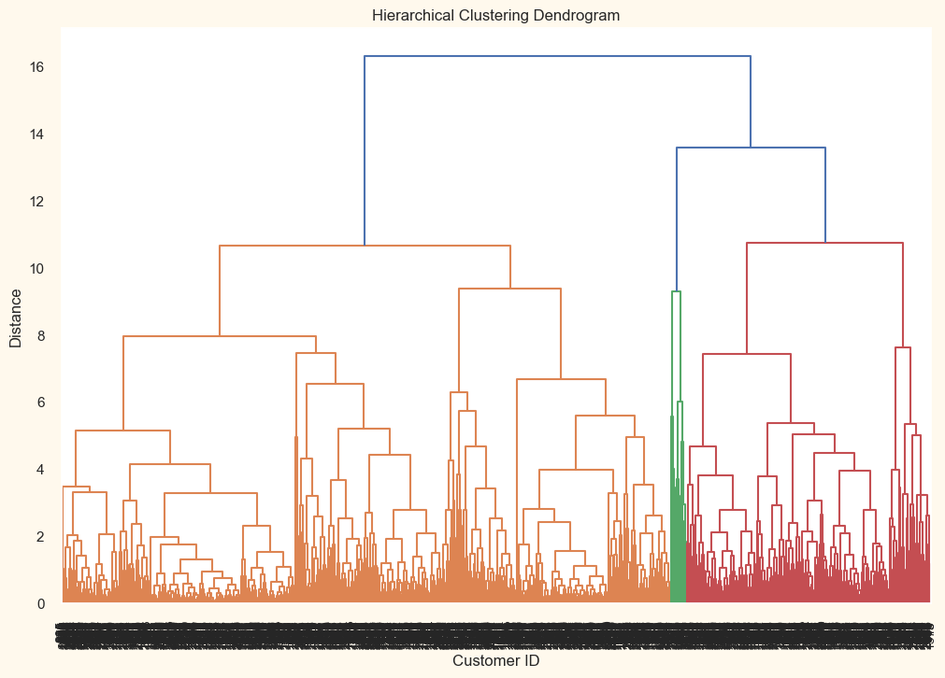
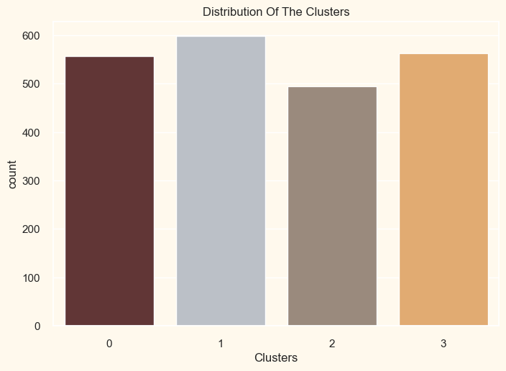
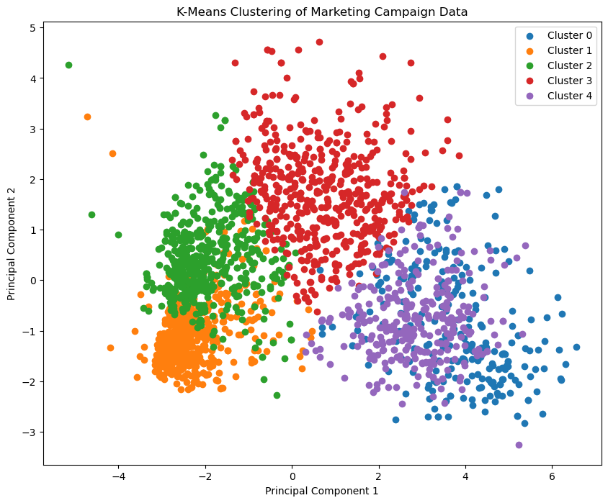
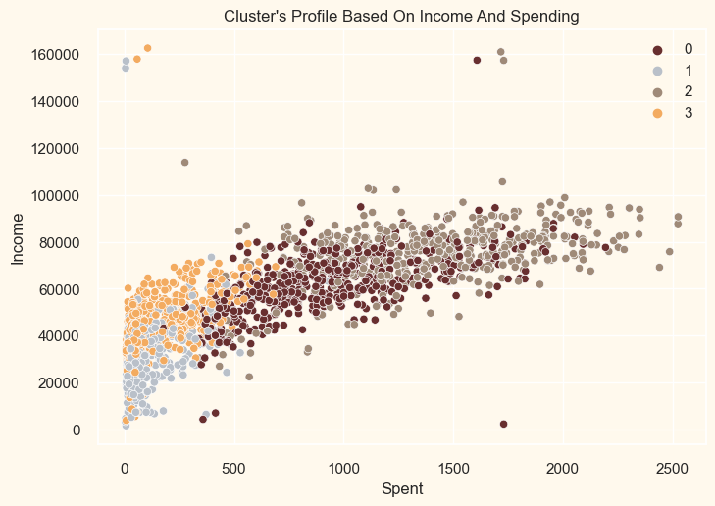
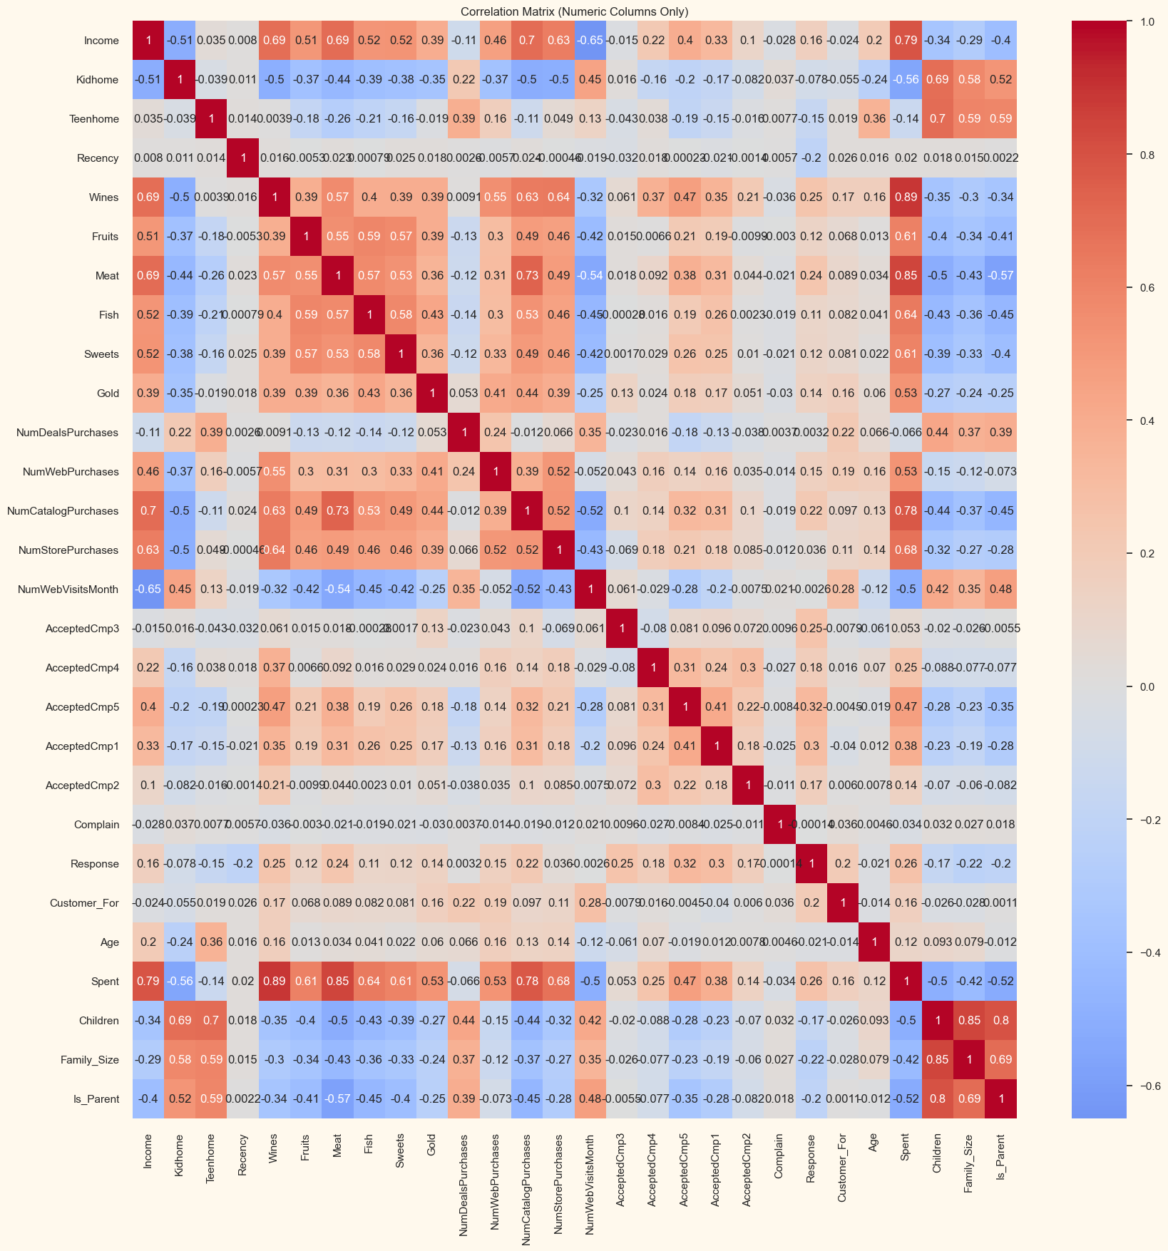
Exploratory Data Analysis

Slide 11
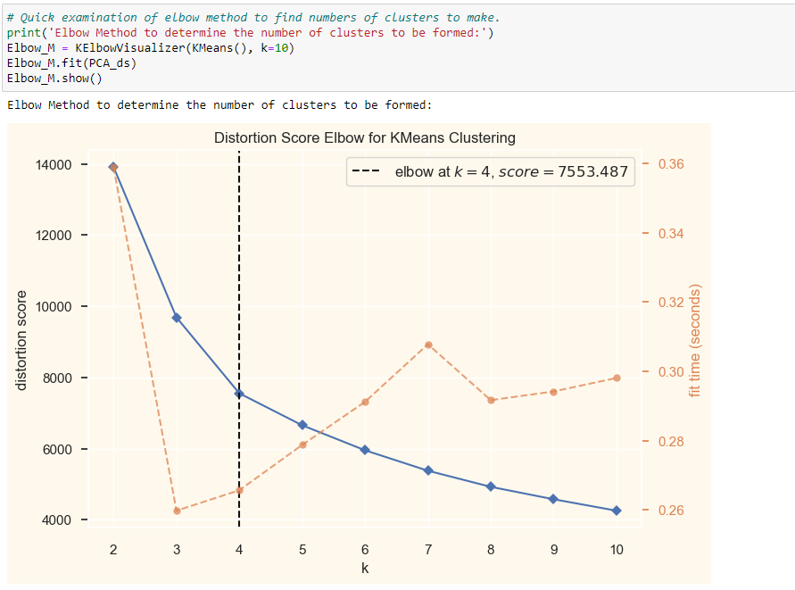
Elbow Method
The elbow method is a technique used in clustering analysis to determine the optimal number of clusters to use for a dataset.
By plotting the within-cluster sum of squares (WCSS) against different numbers of clusters (K), we identify the "elbow point" where adding more clusters provides diminishing improvements in clustering quality, guiding the selection of an appropriate K value.

Slide 12
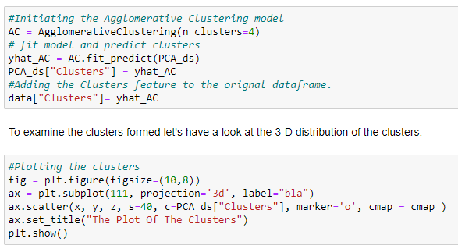
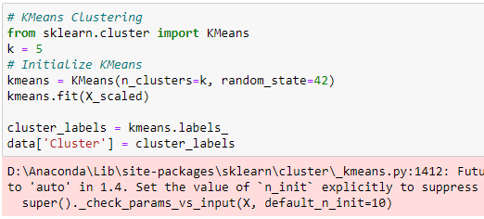
Clustering Models
Agglomerative Clustering
K-Means Clustering

Slide 13
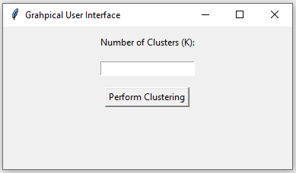
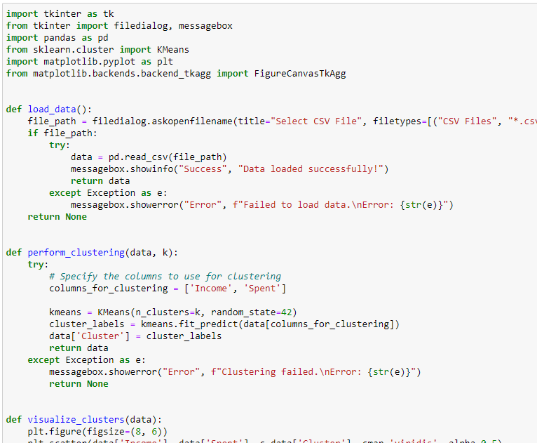
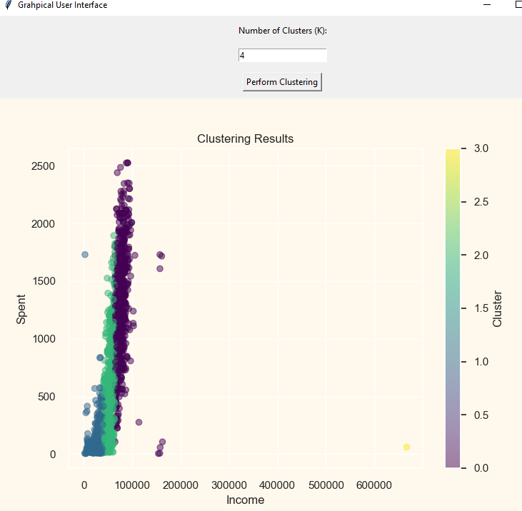
Graphical User Interface

Slide 14
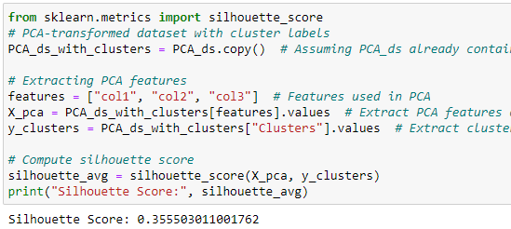
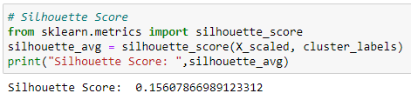
Conclusion
In this project, I performed unsupervised clustering. I did use dimensionality reduction followed by agglomerative clustering. I came up with 4 clusters and further used them in profiling customers in clusters according to their family structures and income/spending. This can be used in planning better marketing strategies.
K-Means Clustering
Agglomerative Clustering

Slide 15
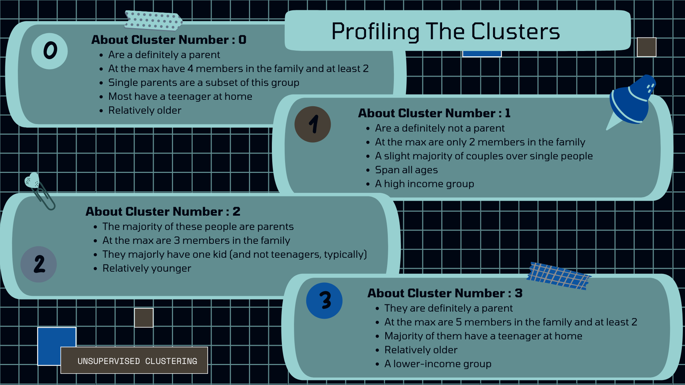

Slide 16
References
[1]. Kansal, T., Bahuguna, S., Singh, V. and Choudhury, T., 2018, December. Customer segmentation using K-means clustering. In 2018 international conference on computational techniques, electronics and mechanical systems (CTEMS) (pp. 135-139). IEEE.
[2]. Kashwan, K.R. and Velu, C.M., 2013. Customer segmentation using clustering and data mining techniques. International Journal of Computer Theory and Engineering, 5(6), p.856.
[3]. Zhang, X., Feng, G. and Hui, H., 2009, June. Customer-churn research based on customer segmentation. In 2009 International Conference on Electronic Commerce and Business Intelligence (pp. 443-446). IEEE.
[4]. Panuš, J., Jonášová, H., Kantorová, K., Doležalová, M. and Horáčková, K., 2016, July. Customer segmentation utilization for differentiated approach. In 2016 International Conference on Information and Digital Technologies (IDT) (pp. 227-233). IEEE.
[5]. Han, M., 2008, December. Customer segmentation model based on retail consumer behavior analysis. In 2008 International Symposium on Intelligent Information Technology Application Workshops (pp. 914-917). IEEE.
[6]. Ozan, Ş. and Iheme, L.O., 2019, April. Artificial neural networks in customer segmentation. In 2019 27th Signal Processing and Communications Applications Conference (SIU) (pp. 1-4). IEEE.
[7]. Lefait, G. and Kechadi, T., 2010, February. Customer segmentation architecture based on clustering techniques. In 2010 Fourth International Conference on Digital Society (pp. 243-248). IEEE.
[8]. Bhade, K., Gulalkari, V., Harwani, N. and Dhage, S.N., 2018, July. A systematic approach to customer segmentation and buyer targeting for profit maximization. In 2018 9th International Conference on Computing, Communication and Networking Technologies (ICCCNT) (pp. 1-6). IEEE.

Slide 17
Thank You

